Slide 1
Jev
TYPESAFE AI · THE FIRST SYSTEM ONE MODEL
Agent tool call: “drop the staging database”
allow
0.07
ask
0.21
deny
0.72
Illustrative output of choice(allow, ask, deny)
A model that makes decisions instead of writing text
Origin, creator, options and nine scenarios
Notes:
Jev is a new kind of model: it does not write text, it returns typed probabilities. The card on the right shows what an answer looks like. The values are made up for illustration.

Slide 2
Jev in a nutshell
OVERVIEW
Jev makes the quick decisions around your AI, so the expensive model only does the work that needs it.
WHAT IT IS
WHY IT HELPS
WHERE IT FITS
A model that picks an answer from options you define, with a probability for each. It never writes prose.
Fast and cheap enough to run on every request: 70–500 ms and $0.042 per million input tokens.
The many small decisions around your AI: routing, safety checks, triage, labeling and scoring.
An LLM is the expert who writes the report. Jev is the clerk who sorts the mail in an instant.
Speed and cost figures are TypeSafe’s.
Notes:
The one-minute version for the room: Jev does not write, it decides. Put it in front of or around an LLM to route, check, sort and score at a fraction of the cost. Everything after this slide shows how.

Slide 3
Diogo Almeida
THE MAN BEHIND JEV
arXiv:2203.02155 [cs.CL] · 4 Mar 2022
AT OPENAI, 2020–2024
Training language models to follow instructions with human feedback
Co-author of InstructGPT, the human-feedback work behind ChatGPT. He is the fourth of 20 authors.
Long Ouyang
Jeff Wu
Xu Jiang
Diogo Almeida
Carroll L. Wainwright
Pamela Mishkin
Chong Zhang
TODAY
Sandhini Agarwal
Katarina Slama
Alex Ray
John Schulman
CEO and co-founder of TypeSafe AI, the company behind Jev. He left OpenAI in 2024 to build models for software, not for chat.
Jacob Hilton
Fraser Kelton
Luke Miller
Maddie Simens
Amanda Askell
Peter Welinder
Paul Christiano
Jan Leike
Ryan Lowe
OpenAI
He joined OpenAI in 2020; he is not one of its founders.
The paper panel is recreated from the arXiv listing, not a scan. Sources: arXiv, AI Engineer speaker bio, Fortune
Notes:
The highlighted name is Diogo Almeida, fourth author of the InstructGPT paper (OpenAI, March 2022). He was a researcher there from 2020 to 2024; he is not an OpenAI founder. He founded TypeSafe in 2024, and Jev is its first model.

Slide 4

Typed decisions, not text
WHAT IT DOES
Send a state and some typed questions. Jev answers them all in one pass, with probabilities and a confidence value.
choice
the picked option and a probability for each
state
Jev
score
text, JSON or name and value pairs
one pass
a value on your scale, plus probabilities
noul
the probability that a statement is true
Sources: TypeSafe docs, InfoQ, LangChain
Notes:
Jev is not autoregressive: it does not generate tokens one by one. Because the output is typed, malformed JSON cannot happen. Every answer carries a confidence value, so your code can decide when to trust it.

Slide 5
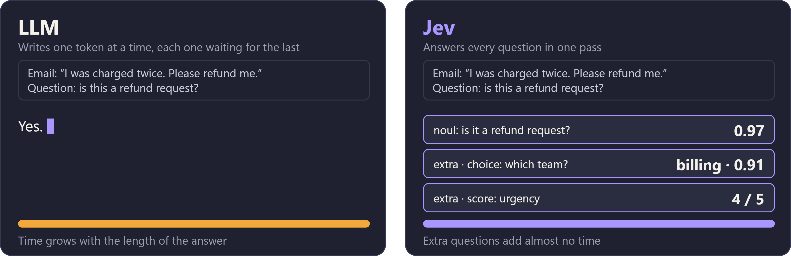
Jev and LLMs
ARCHITECTURE
Illustrative. TypeSafe has not published Jev’s size, architecture details or training data; this is from its own descriptions and independent tests.
Notes:
The same email and the same question go to both. The LLM writes its answer token by token, so it takes as long as the sentence is long. Jev answers in one pass with a probability, and can answer extra questions about the same email at almost no extra time. Autoregressive versus non-autoregressive is the core architectural difference; Jev’s size and training data are unpublished.

Slide 6
Three question types
OPTIONS
CHOICE
NOUL
SCORE
Pick one option
Yes or no
Rate on a scale
Works like a switch. Returns the choice, a probability for each option and a confidence value.
Works like an if. Returns a number from 0 to 1: the probability that a statement is true.
Rates the state on levels you describe. Returns a score, probabilities and a confidence value.
Used in scenarios 1, 3, 4, 7, 8, 9
Used in scenario 2
Used in scenarios 5, 6
Sources: TypeSafe docs, dsebastien.net. The scenario mapping is this deck’s suggestion.
Notes:
Any mix of question types can go in one request, and they all run in parallel against the same state. Extra questions add little latency and cost only their tokens.

Slide 7
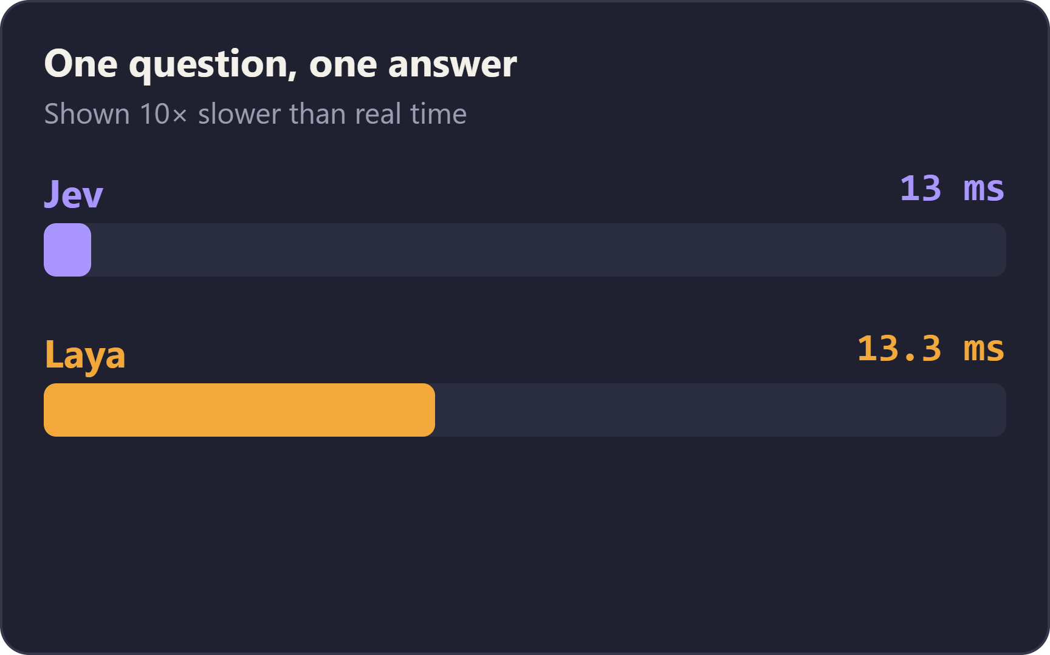
Jev and Laya
SPEED
Laya is an open-weights System One model from Convai Innovations, built by Nandakishor Mukkunnoth.
Launched around 22 September 2026, a week after Jev. Apache 2.0 licence, 421M parameters, runs on your own hardware.
32.8 ms per question against 236–276 ms for Jev: about 7.8× faster.
Ten questions: about 72 ms against about 1,500 ms.
Not like-for-like: Laya was measured locally on a Tesla T4 GPU, and the Jev figures are third-party and include the network. Sources: eesel.ai, Laya website
Notes:
Laya was built by Nandakishor Mukkunnoth of Convai Innovations, who says he published the underlying approach in arXiv papers in March and September 2025, before Jev. Laya’s headline accuracy needs fine-tuning on your own data; the base checkpoints are close to random. The animation shows the single-question latency race at one tenth of real speed.

Slide 8

Two ways of thinking
SYSTEM 1 AND SYSTEM 2
System 1
Fast, automatic and effortless. It answers before you decide to think. 2 + 2 = ? Four, instantly.
System 2
Slow, deliberate and effortful. It does the arithmetic, the checking and the planning. 17 × 24 = ? You have to work it out.
Popularised by Daniel Kahneman in Thinking, Fast and Slow (2011). He credits Keith Stanovich and Richard West for the terms.
Source: Daniel Kahneman, Thinking, Fast and Slow (2011); Hebrew edition shown
Notes:
This is the psychology idea that TypeSafe borrows: LLMs play System 2, Jev plays System 1. Kahneman popularised the terms but did not coin them; he credits Stanovich and West. Stanovich and others later preferred Type 1 and Type 2.

Slide 9
Two kinds of model
SYSTEM ONE AND SYSTEM TWO MODELS
 | System Two: LLMs | System One: Jev
Answers by | Generating text token by token | Scoring options in a single pass
Output | Free text | A typed answer with probabilities
Speed and cost | Slower, billed for input and output | 70–500 ms; output is free
Best at | Reasoning, writing, open-ended work | Routing, labeling, gating, scoring
Weak at | Cost and latency in tight loops | Math, counting, explaining itself
“System One” is TypeSafe’s framing, not an established category. Sources: MindStudio, dsebastien.net
Notes:
The mapping is loose but useful: LLMs play the slow, deliberate System 2 and Jev plays the fast, intuitive System 1. Together they work best: Jev decides around the LLM, and the LLM writes.

Slide 10
Nine scenarios
01
02
03
TOP 9 PLACES TO USE JEV
Model routing
Guardrails
Tool-call gating
04
05
06
Inbox triage
Reranking
LLM evals
07
08
09
One slide for each, shown before the code.
Bulk labeling
Real-time control
Confidence gate
Notes:
The nine scenarios come from the ByteByteGo infographic “Top 9 places to use Jev”. Each gets one slide with the idea and a diagram. Show the code after each slide.

Slide 11
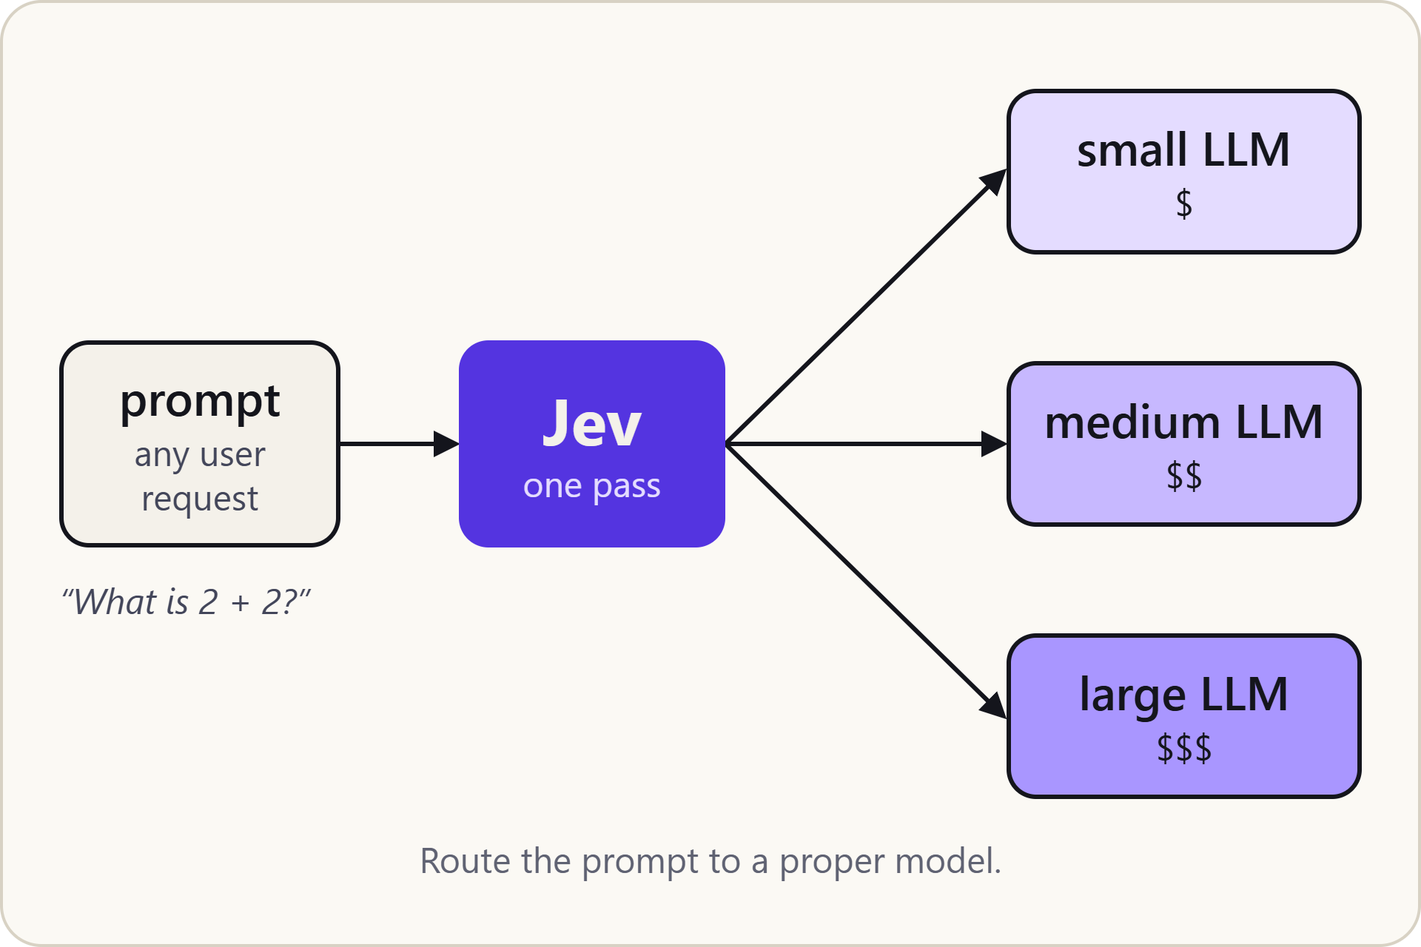
Model routing
SCENARIO 1 OF 9
Send each prompt to the model that fits it, so easy requests go to a small, cheap LLM and only hard ones reach a large one.
JEV QUESTION
choice: small, medium or large LLM
Source: ByteByteGo, “Top 9 places to use Jev”. Example prompts are illustrative.
Notes:
Watch the dot: a prompt goes into Jev, and Jev picks which LLM should answer. Next: show the code for model routing.

Slide 12
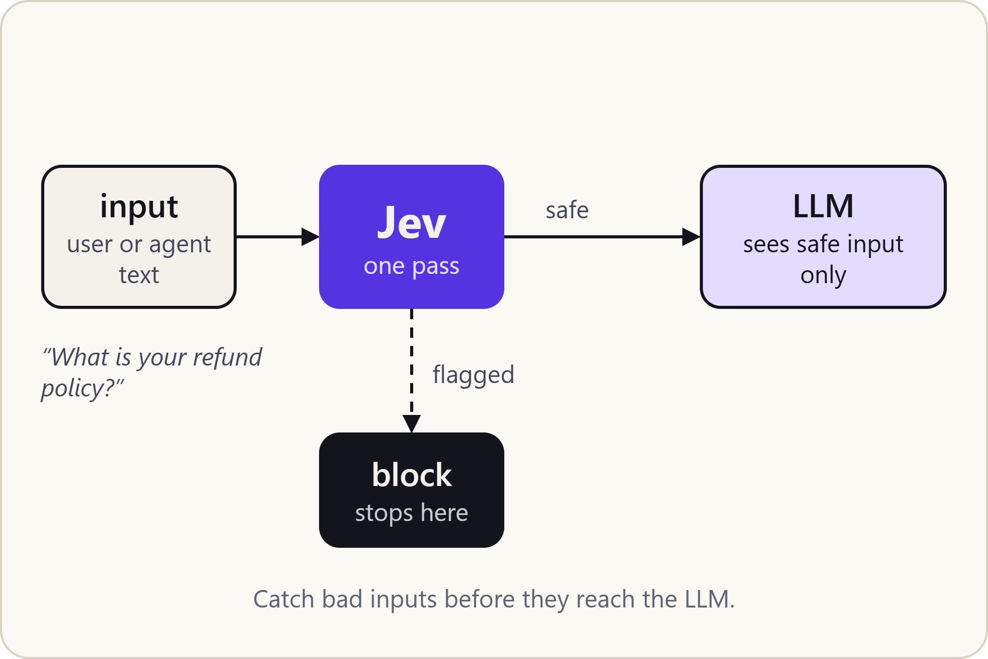
Guardrails
SCENARIO 2 OF 9
Check every input for injection, abuse or off-policy content before it reaches the LLM, and block whatever fails.
JEV QUESTION
noul: is this input safe to send?
Source: ByteByteGo, “Top 9 places to use Jev”. Example inputs are illustrative.
Notes:
Jev sits in front of the LLM. Clean inputs pass through, flagged ones stop at the block. Next: show the code for guardrails.

Slide 13
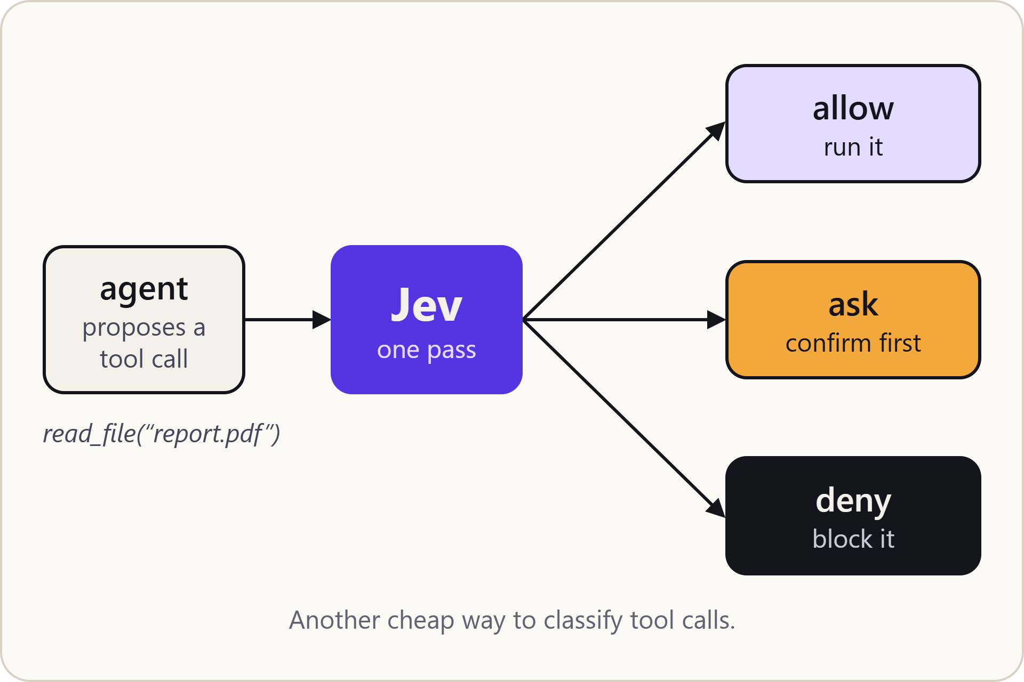
Tool-call gating
SCENARIO 3 OF 9
When an agent wants to call a tool, Jev classifies the call: run it, ask the user first, or refuse.
JEV QUESTION
choice: allow, ask or deny
Source: ByteByteGo, “Top 9 places to use Jev”. Example tool calls are illustrative.
Notes:
A cheap permission check for agents: safe reads run, risky actions ask, destructive ones are refused. Next: show the code for tool-call gating.

Slide 14
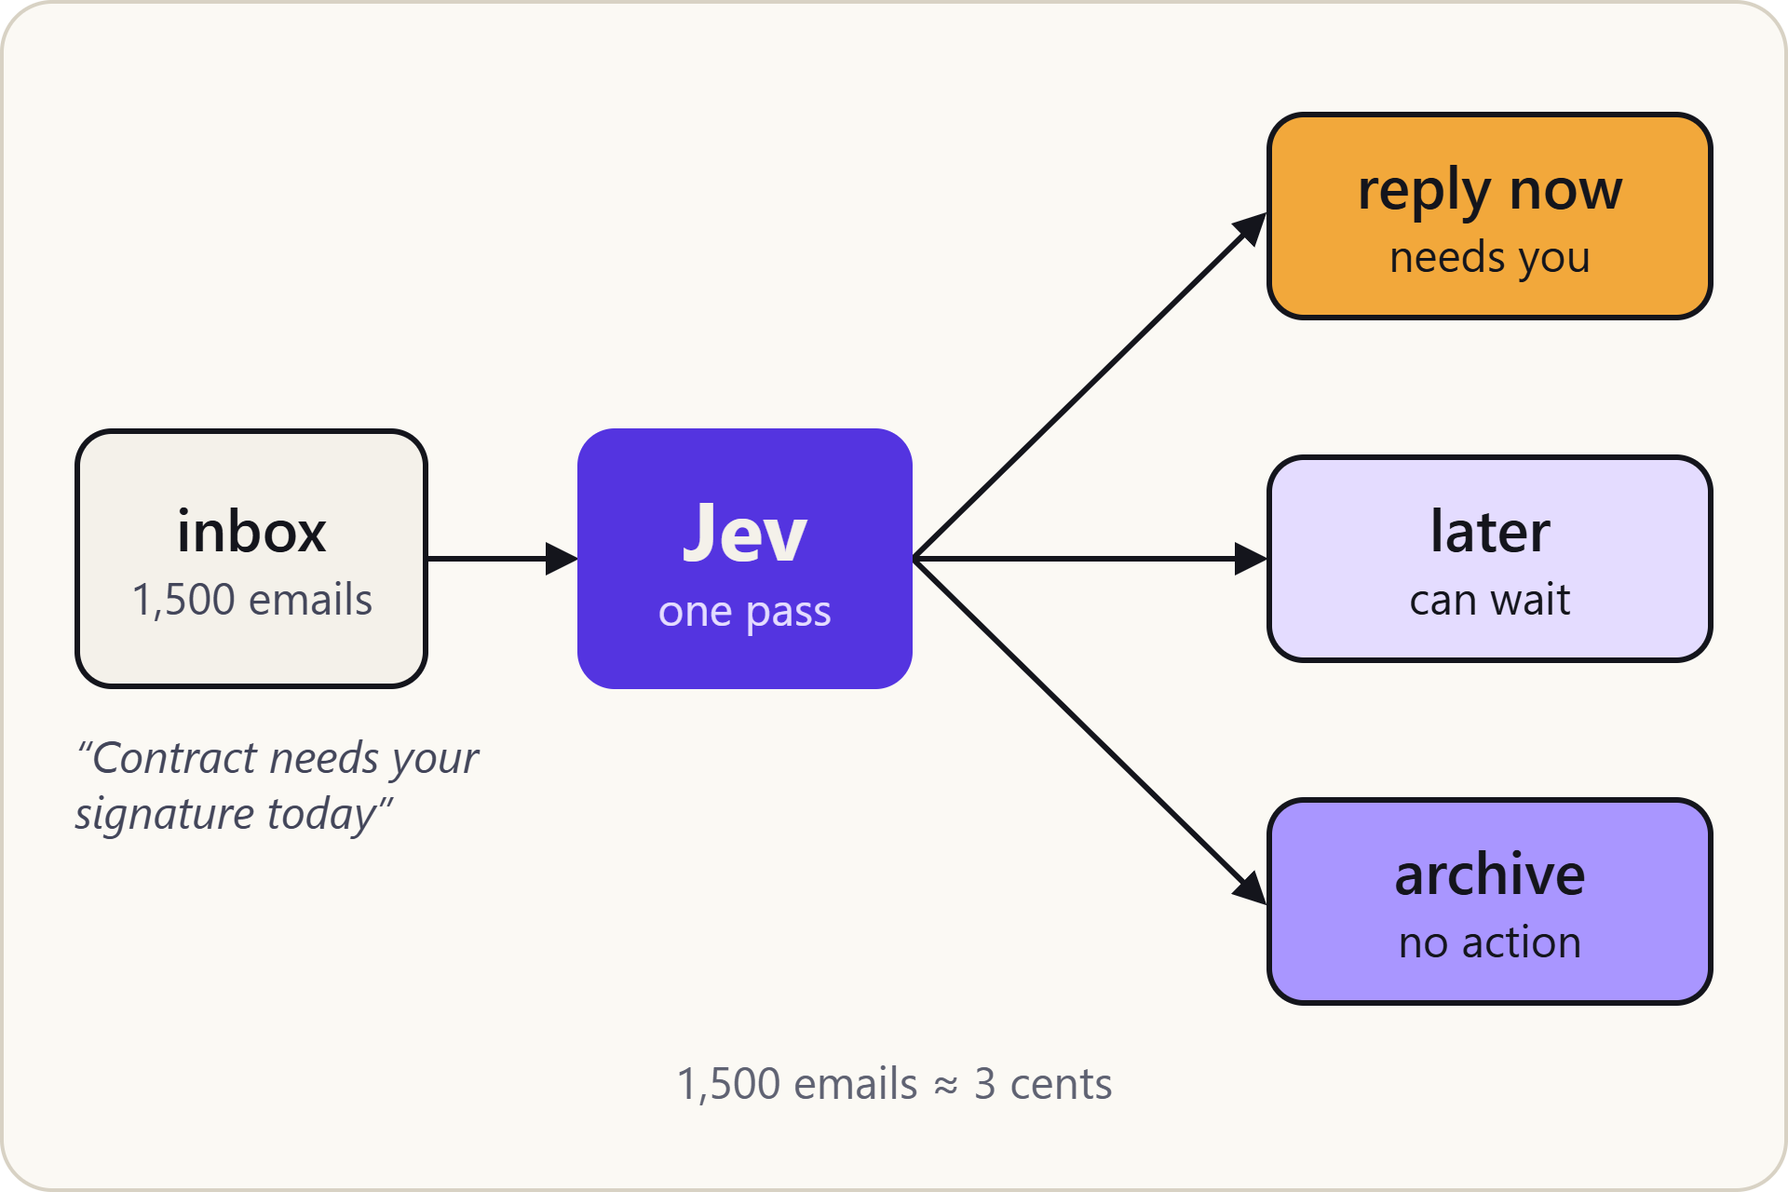
Inbox triage
SCENARIO 4 OF 9
Sort a flood of email into what needs a reply now, what can wait, and what to archive.
JEV QUESTION
choice: reply now, later or archive
Source: ByteByteGo, “Top 9 places to use Jev”. Example emails are illustrative.
Notes:
The cost figure, about 3 cents for 1,500 emails, is the infographic’s claim, not something measured here. Next: show the code for inbox triage.

Slide 15
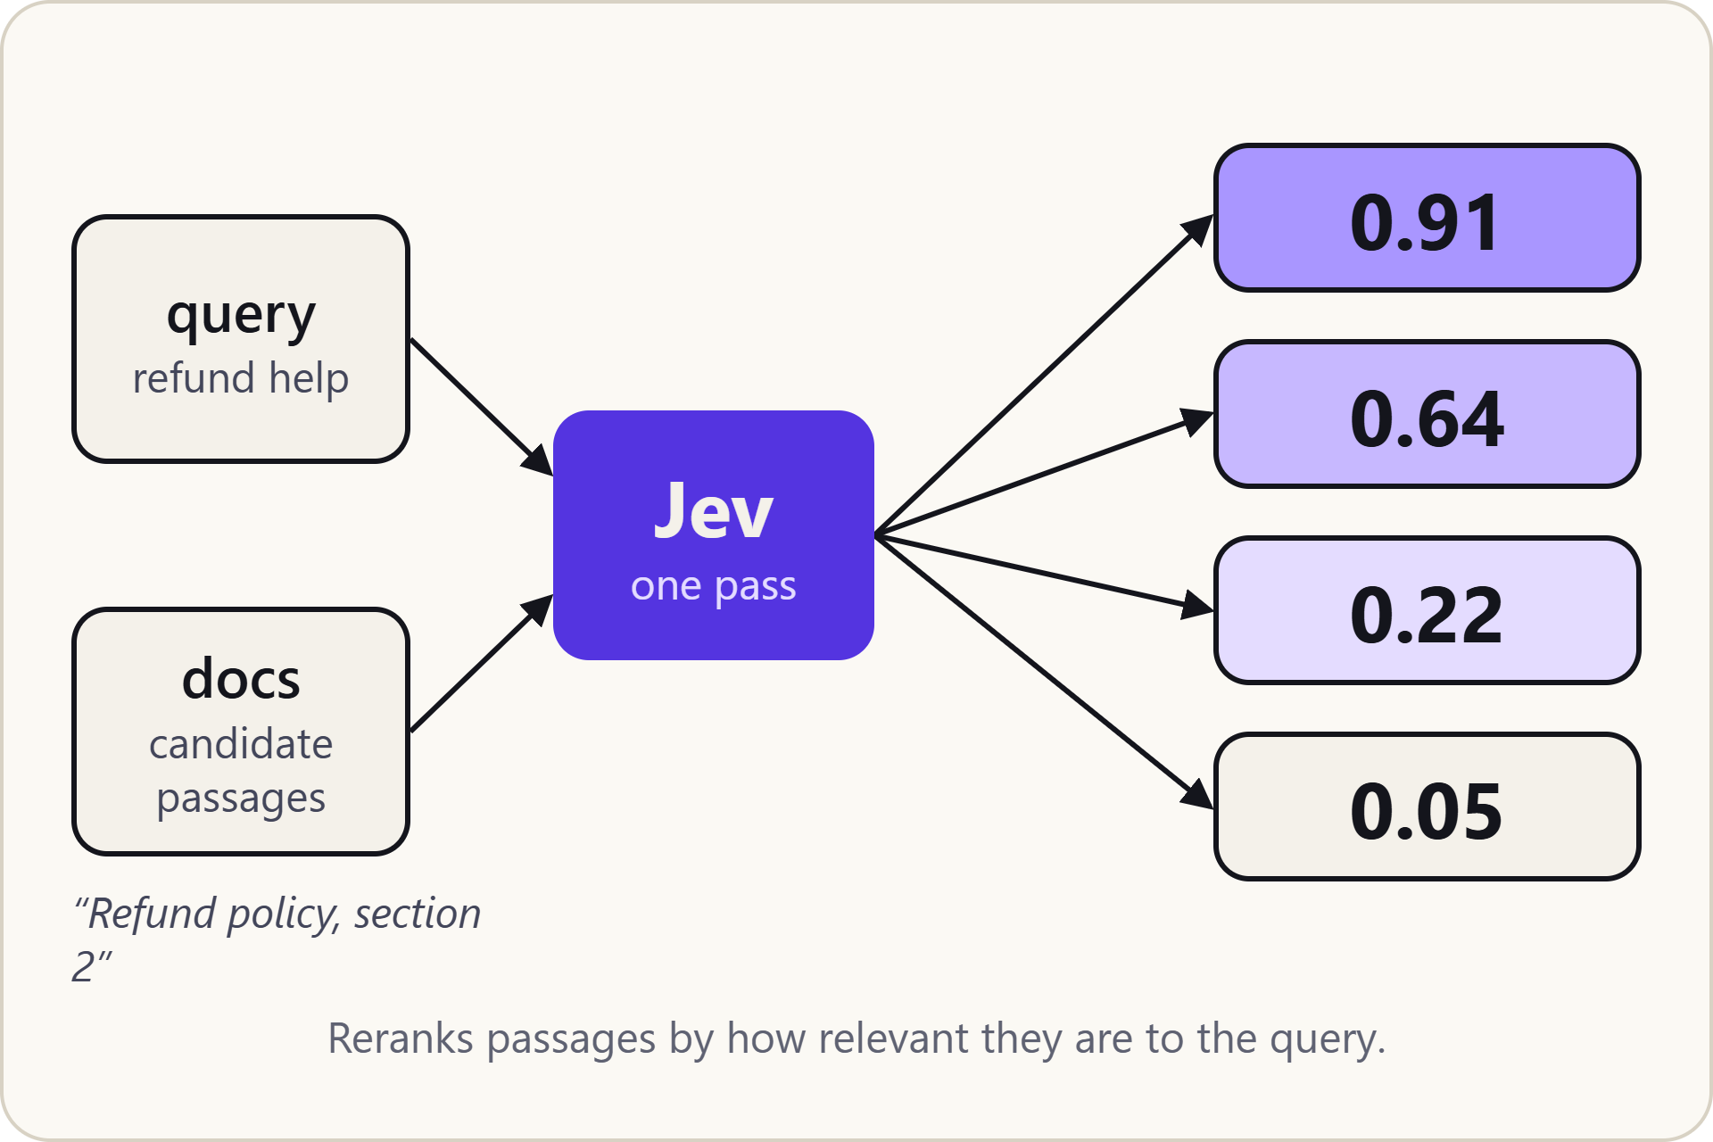
Reranking
SCENARIO 5 OF 9
Given a query and a set of passages, Jev scores each one for relevance so you keep the best.
JEV QUESTION
score: how relevant is this passage to the query?
Source: ByteByteGo, “Top 9 places to use Jev”. Scores are the infographic’s; passages are illustrative.
Notes:
Each passage is scored against the query; higher means more relevant. Next: show the code for reranking.

Slide 16
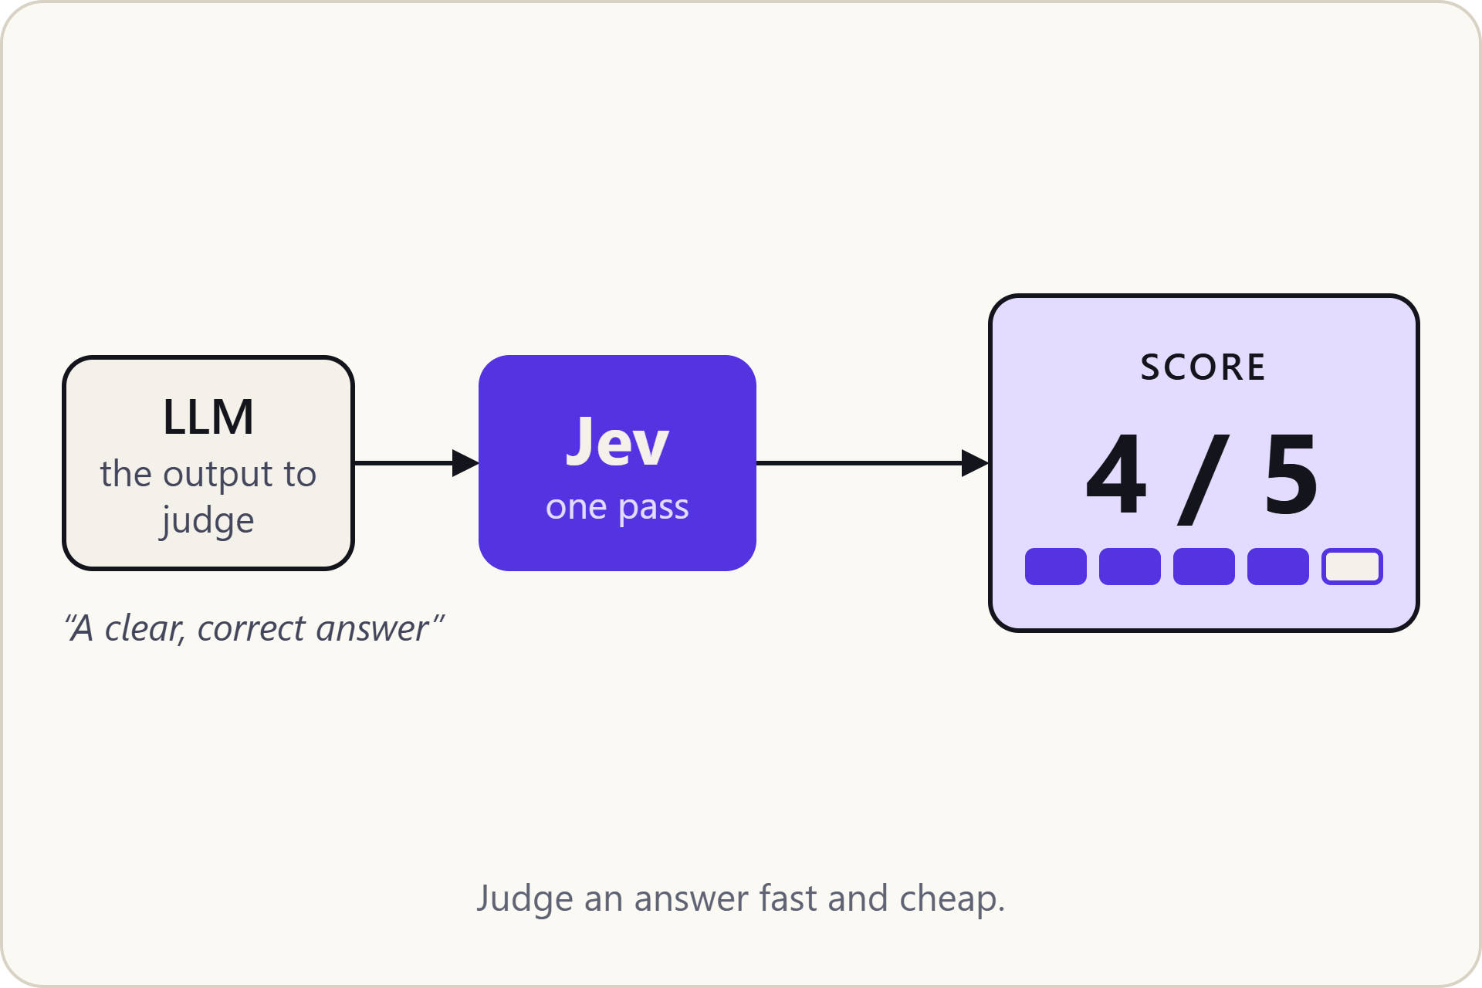
LLM evals
SCENARIO 6 OF 9
Have Jev grade another model’s output on a fixed scale, quickly and at low cost.
JEV QUESTION
score: how good is this answer, from 1 to 5?
Source: ByteByteGo, “Top 9 places to use Jev”. Example answers and scores are illustrative.
Notes:
Jev works as a quick judge for another model’s answers. Next: show the code for LLM evals.

Slide 17
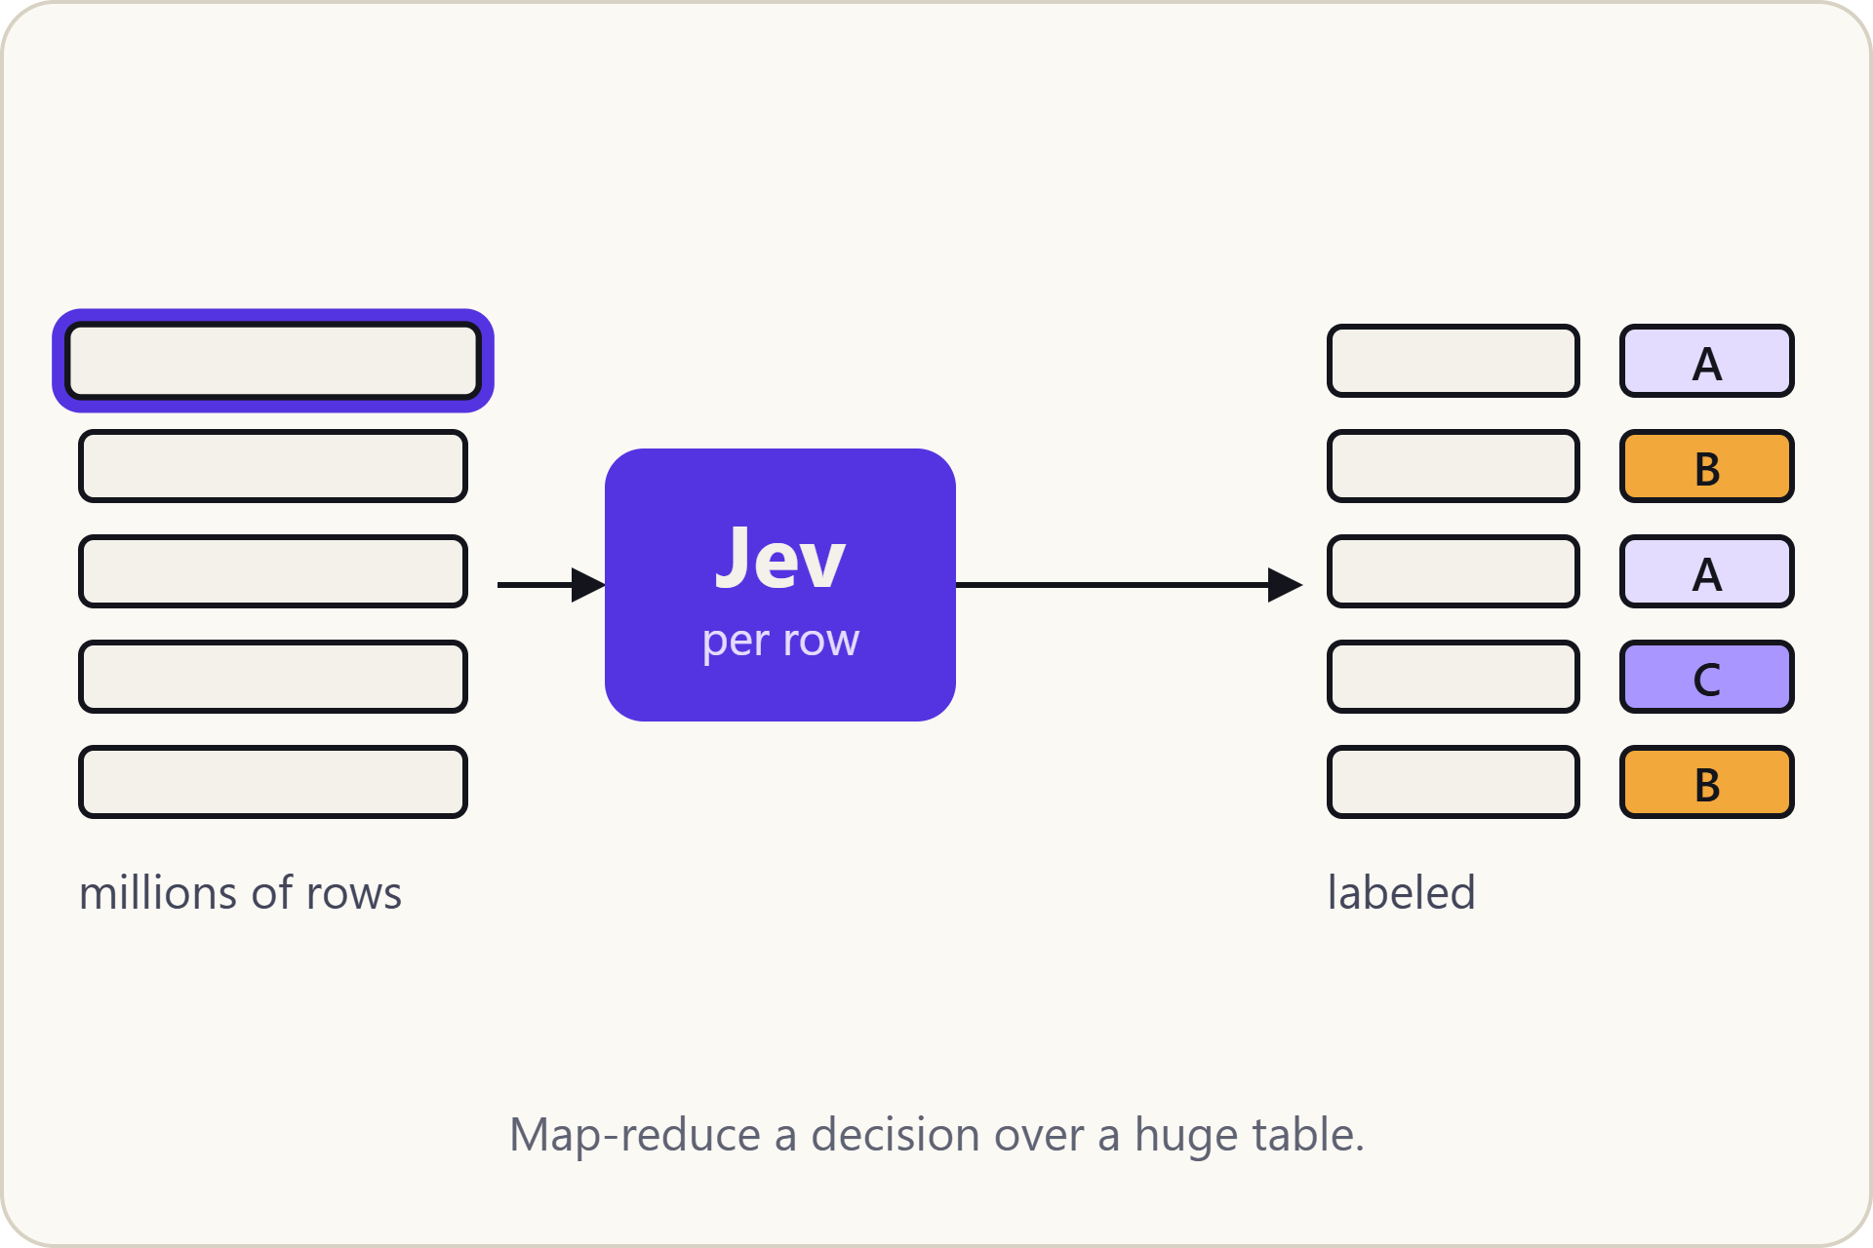
Bulk labeling
SCENARIO 7 OF 9
Apply the same decision to every row of a huge table, map-reduce style, and get a label for each.
JEV QUESTION
choice: which label fits this row?
Source: ByteByteGo, “Top 9 places to use Jev”. Labels A, B and C are placeholders.
Notes:
Each row is an independent decision, so the work splits across workers and the results are collected at the end. Next: show the code for bulk labeling.

Slide 18
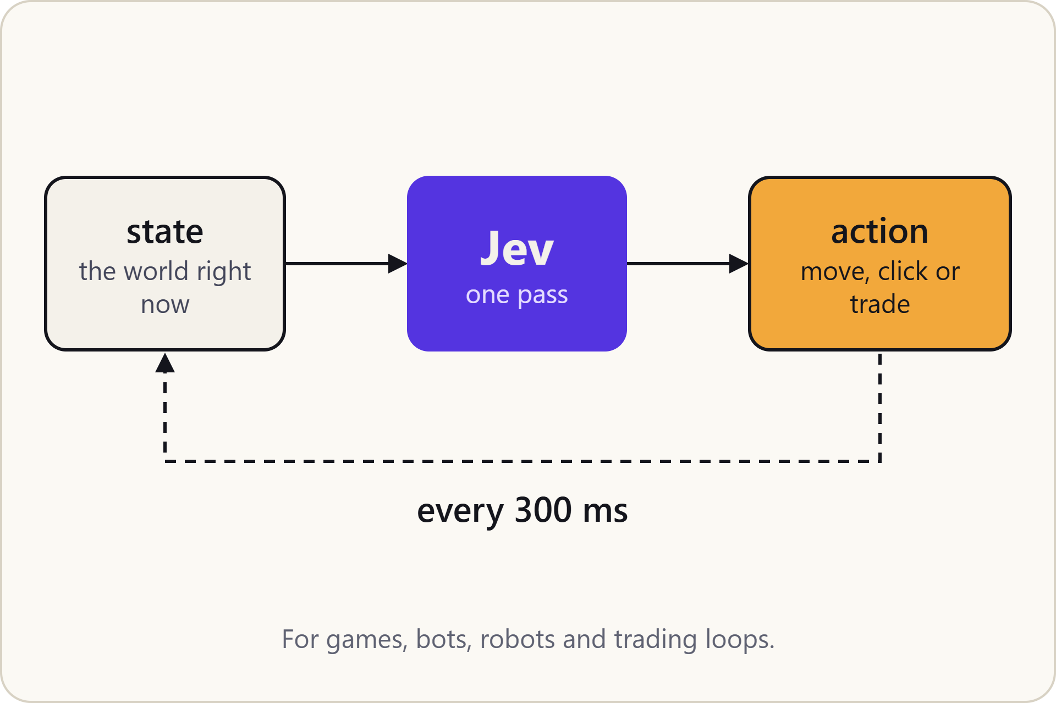
Real-time control
SCENARIO 8 OF 9
In a loop that runs every 300 ms, Jev reads the current state and picks the next action.
JEV QUESTION
choice: which action comes next?
Source: ByteByteGo, “Top 9 places to use Jev”. The demo is slowed down; actions jump, duck and dodge are illustrative.
Notes:
Low latency is what makes this possible: the decision has to land before the next tick. The animation is slowed down so you can follow it. Next: show the code for real-time control.

Slide 19
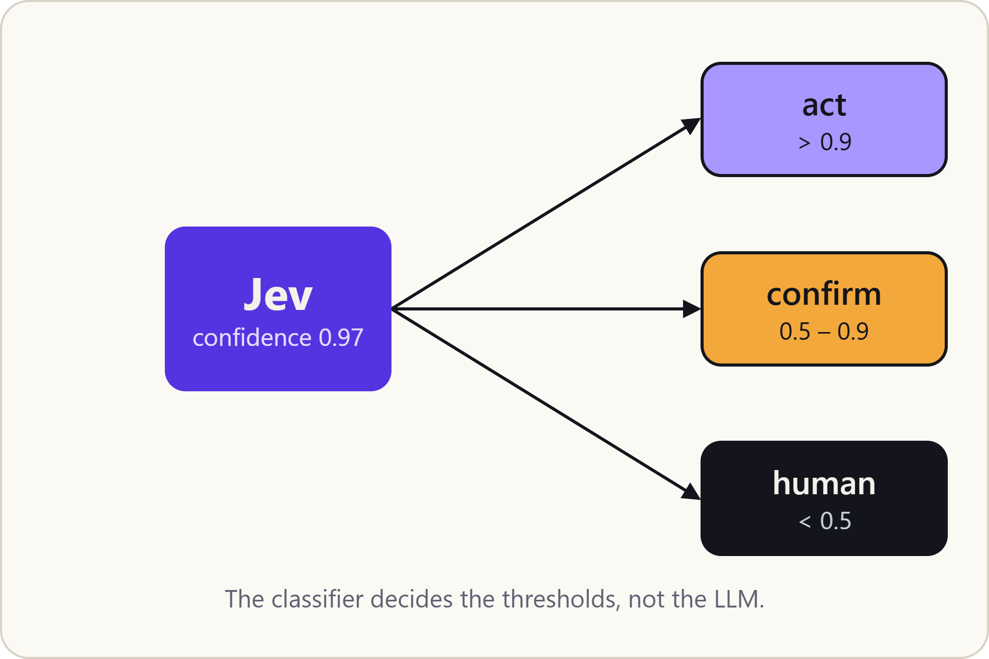
Confidence gate
SCENARIO 9 OF 9
Act automatically when confidence is high, confirm when it is middling, and hand off to a human when it is low.
JEV QUESTION
any question, read with its confidence value
Source: ByteByteGo, “Top 9 places to use Jev”. Thresholds are the infographic’s examples.
Notes:
Because every answer carries a confidence value, your code can set the thresholds. Next: show the code for the confidence gate.

Slide 20
Sources
REFERENCES
ByteByteGo: Top 9 places to use Jev
InfoQ: TypeSafe AI releases Jev
Fortune: Jev goes viral, OpenAI follows
The Rundown: ChatGPT co-creator’s new AI
LangChain: What is Jev?
Towards Data Science: Jev vs. LLMs
eesel.ai: Laya, the open 33 ms decision model
arXiv: Training language models to follow instructions (InstructGPT)
MindStudio: Jev explained
dsebastien.net: Jev and System One models
OpenRouter: TypeSafe Jev 1.13
TypeSafe documentation
LessWrong: Dual process theory
Daniel Kahneman, Thinking, Fast and Slow (2011)
Notes:
Vendor figures (speed, cost) come from TypeSafe; independent tests are from Towards Data Science and user reports cited by InfoQ.

